Slide 1
Mech Warfare Target System Construction
D. Croft

Slide 2
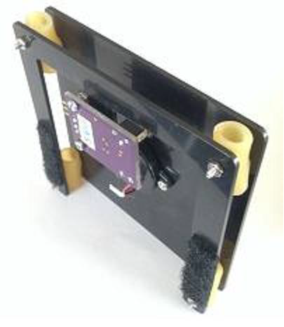
Finished Target Plate

Slide 3
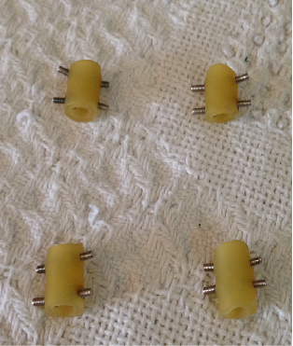
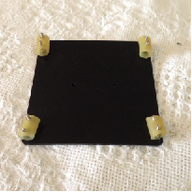
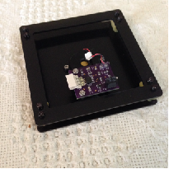
Target Plate Construction
Method 1 – Bolt thru rubber Hose
Pre-drill holes thru rubber house to make attaching bolts easier.
Bolt to target plate and use thread locker.
Finished Target Plate

Slide 4
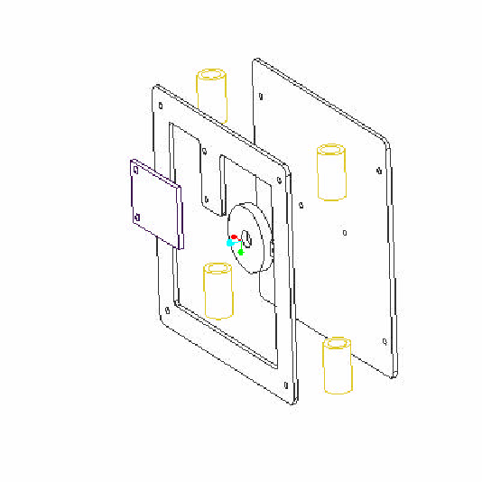
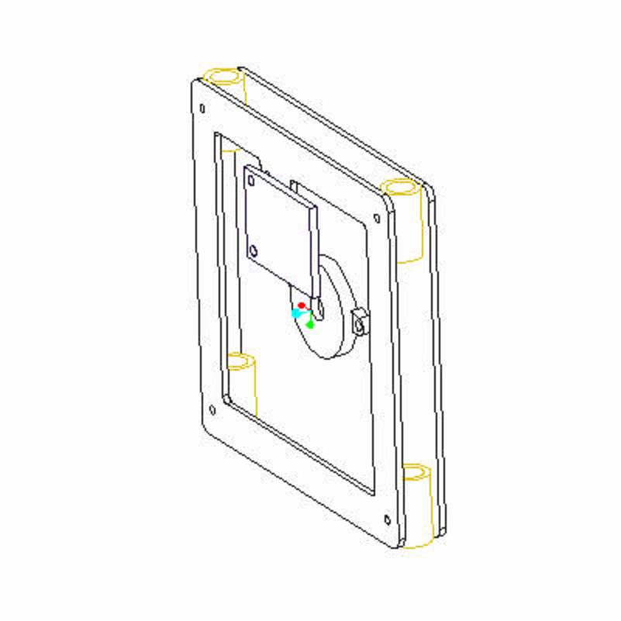
Target Plate Construction Exploded View
Target Plate size is 3.5" x 3.5 ". Material is 0.063" Delrin (Acetal) from Zoro. (http://www.zoro.com/i/G0518481) (Could also use aluminum sheet. The first prototype was aluminum and it worked fine. Other Materials may work.)
Note: This depiction shows the bolt on style piezo.

Slide 5
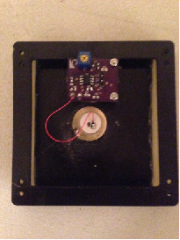
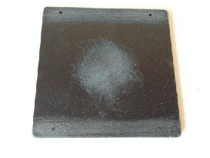
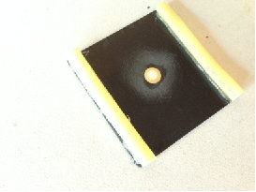
Target Plate Construction
Method 2 – Hot Glue Gun the Rubber to the Target Plate
Sand edges so hot glue sticks
Hot glue rubber hose to target plate (both sides)
Finished Target Plate
Signal is inside portion of piezo.
Ground is outside of ring of piezo
Sand center so piezo sticks
Carefully solder wires to piezo plate. I found it easiest if large blob of flux was used on piezo and then quickly apply solder with tip of solder iron
Epoxy Piezo to center of target plate

Slide 6
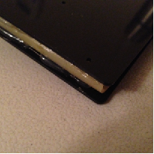
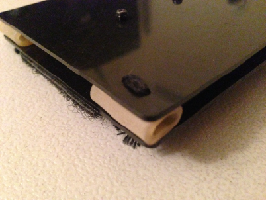
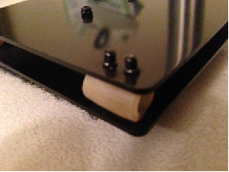
Target Plate Attachment Options
Hot Glue – May not be as robust as other methods
Sew the plates thru the rubber hose. Not easy to do.
Bolt the plates thru the rubber hose. Not easy to do.

Slide 7
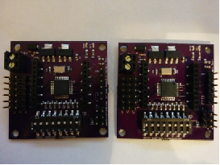
Transponder Board
Multiple Variants of this Board Exist.
LED Board
Target Plate 4
Target Plate 3
Target Plate 2
Target Plate 1
Gnd
(+/Rtn)
Signal
Mech Target System ID

Slide 8
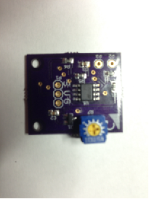
Target Filter Board
Multiple Variants of this Board Exist.
Signal
Power
Ground
Potentiometer to adjust target filter sensitivity.

Slide 9
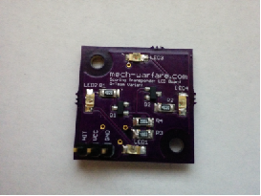
Target LED Board
Multiple Variants of this Board Exist.
From Transponder Board “HIT” Jumpers
Hit
Power
Gnd

